Slide 1
Computer Network Security
TE - IT
Lecture -23
14/09/2021
Session: 11:00 - 1:00 PM

Slide 2
Let us first discuss the electronic mail (e-mail) system in general.
16-1 E-MAIL
Topics discussed in this section:
E-mail Architecture
E-mail Security

Slide 3


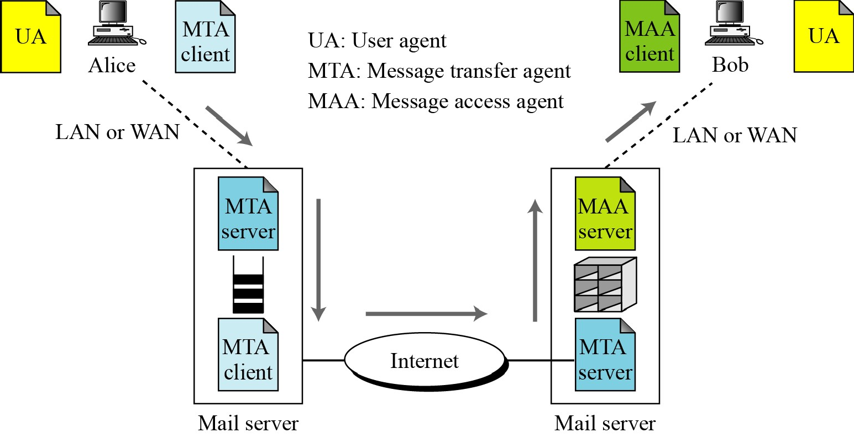
Figure 16.1 E-mail architecture
16.1.1 E-mail Architecture

Slide 4

Cryptographic Algorithms
16.1.2 E-mail Security
Note
In e-mail security, the sender of the message needs to include the name or identifiers
of the algorithms used in the message.
Certificates
It is obvious that some public-key algorithms must be used for e-mail security.

Slide 5
Cryptographic Secrets
16.1.2 Continued
Note
In e-mail security, the encryption/decryption is done using a symmetric-key algorithm,
but the secret key to decrypt the message is encrypted with the public key of the
receiver and is sent with the message.

Slide 6
Pretty Good Privacy (PGP) can be used to create a secure e-mail message or to store a file securely for future retrieval.
16-2 PGP
One of the protocols to provide security at the application layer is Pretty Good Privacy (PGP).
PGP is designed to create authenticated and confidential e-mails.

Slide 7
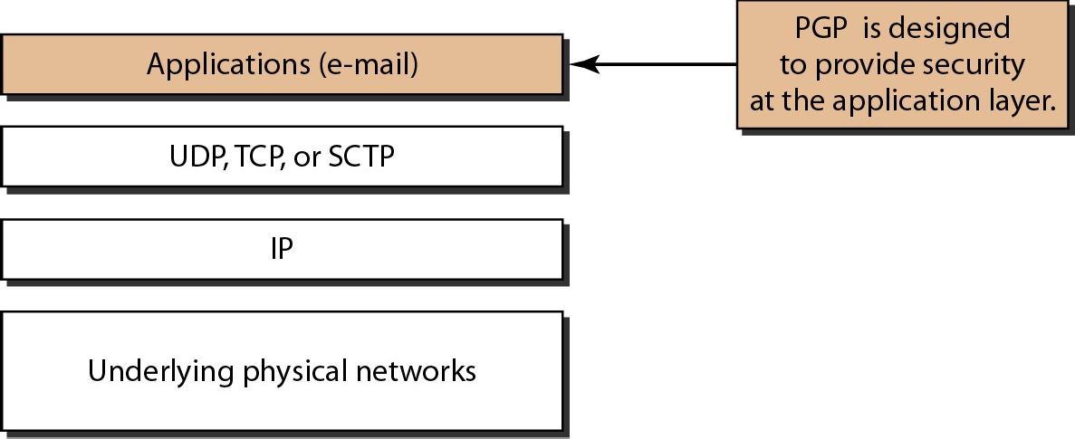
Figure 32.19 Position of PGP in the TCP/IP protocol suite

Slide 8
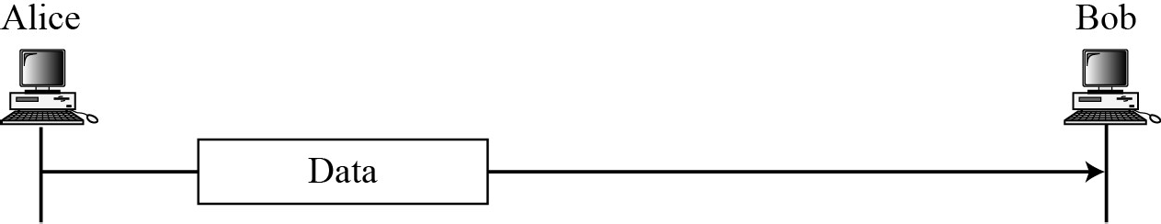
16.2.1 Scenarios
Plaintext
Figure 16.2 A plaintext message

Slide 9
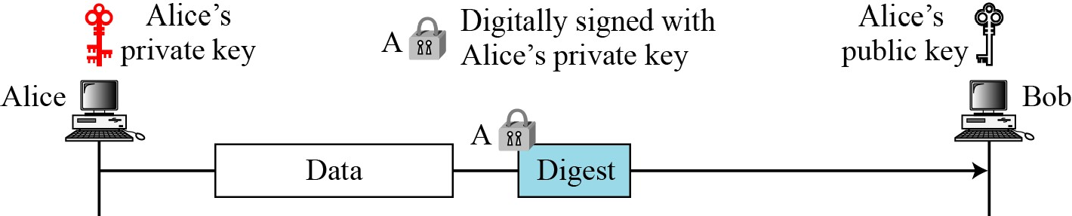
16.2.1 Continued
Message Integrity
Figure 16.3 An authenticated message
10

Slide 10
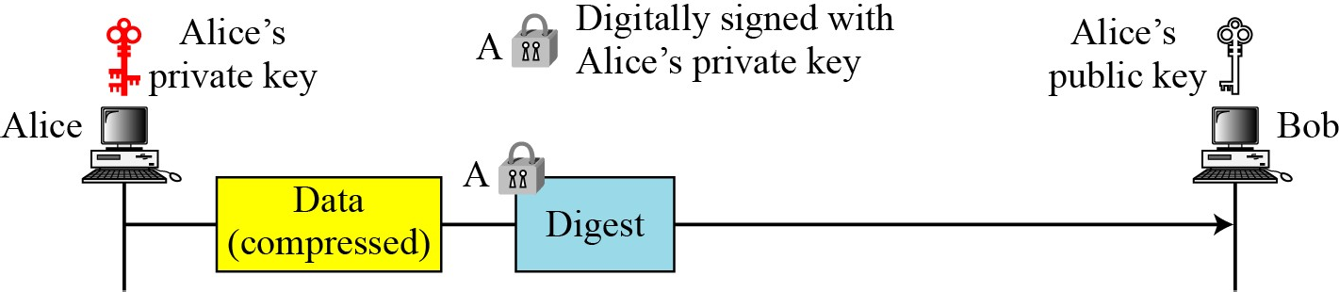
16.2.1 Continued
Compression
Figure 16.4 A compressed message

Slide 11
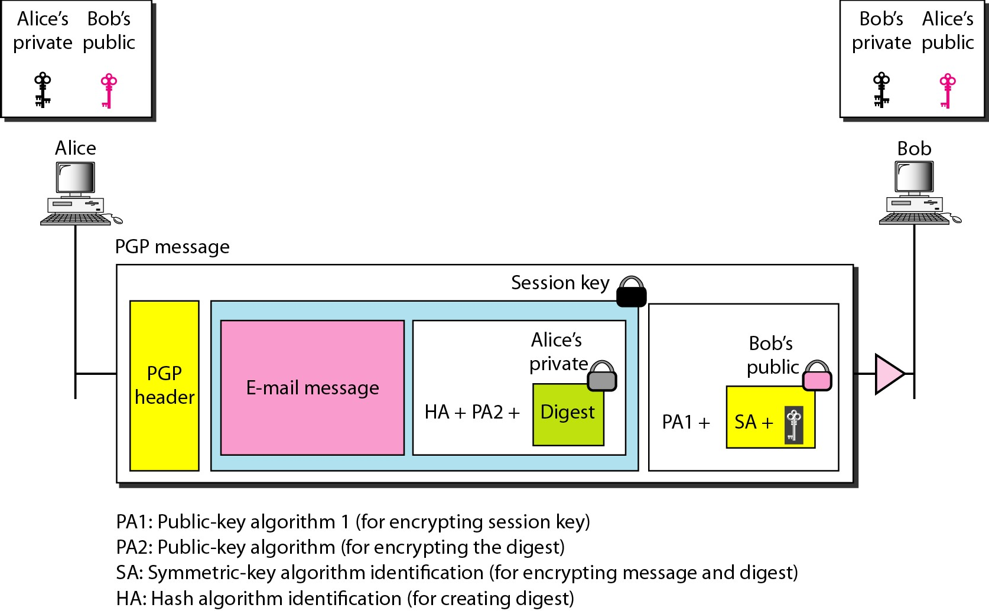
Figure 32.20 A scenario in which an e-mail message is
authenticated and encrypted

Slide 12
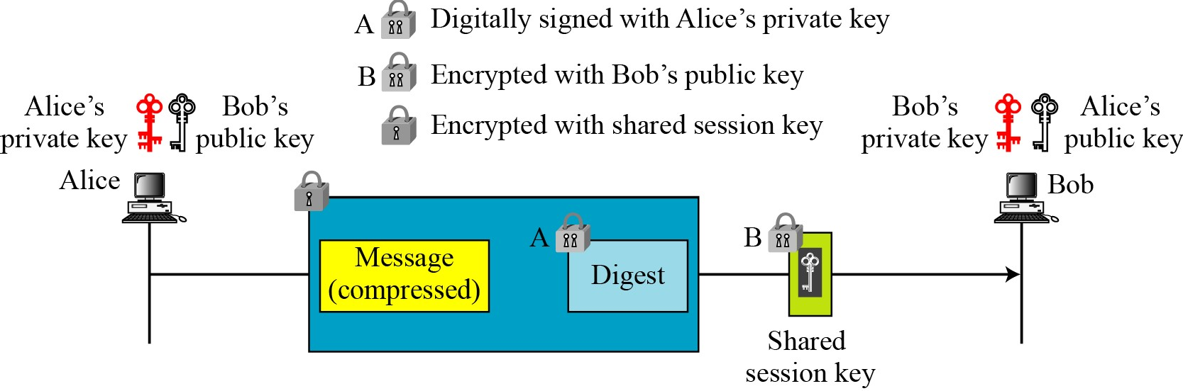
PGP Services
Confidentiality with One-Time Session Key
Figure 16.5 A confidential message

Slide 13
Code Conversion
Another service provided by PGP is code conversion. PGP uses Radix-64 conversion.
16.2.1 Continued
Segmentation
PGP allows segmentation of the message.

Slide 14
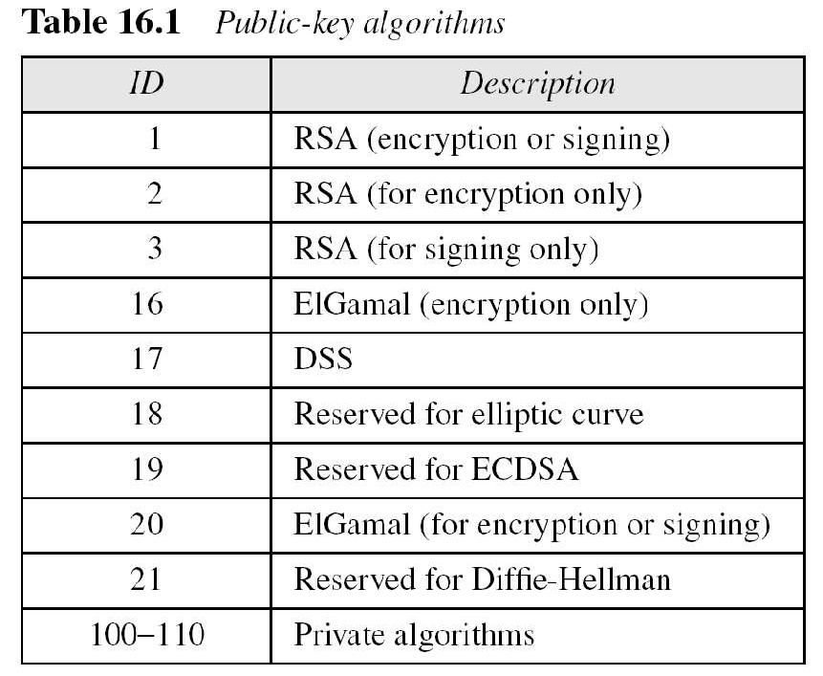
PGP Algorithms
16.2.2 Continued

Slide 15
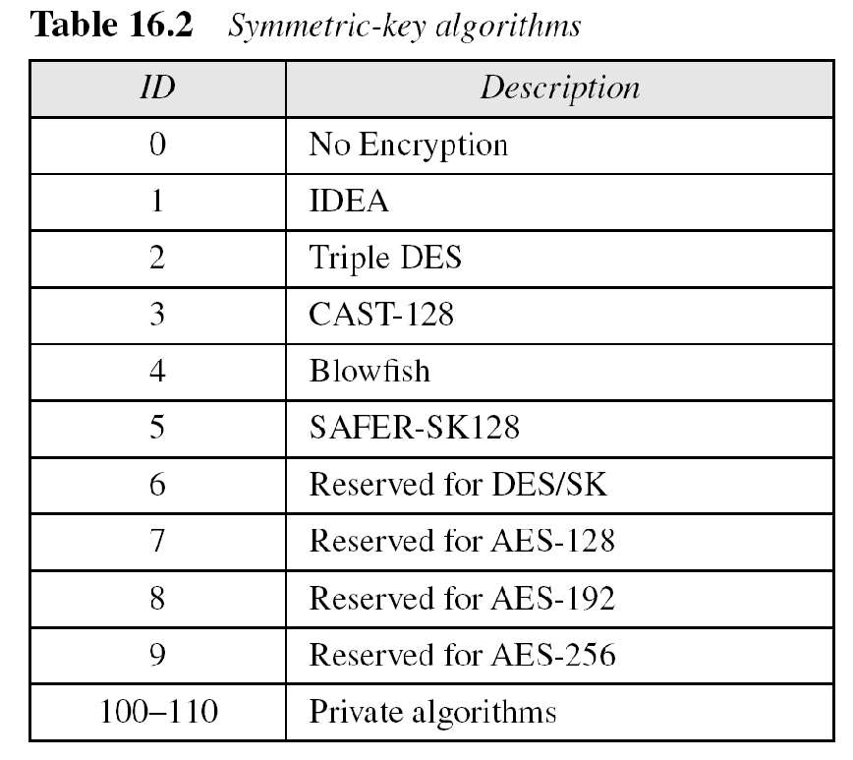
16.2.2 Continued

Slide 16
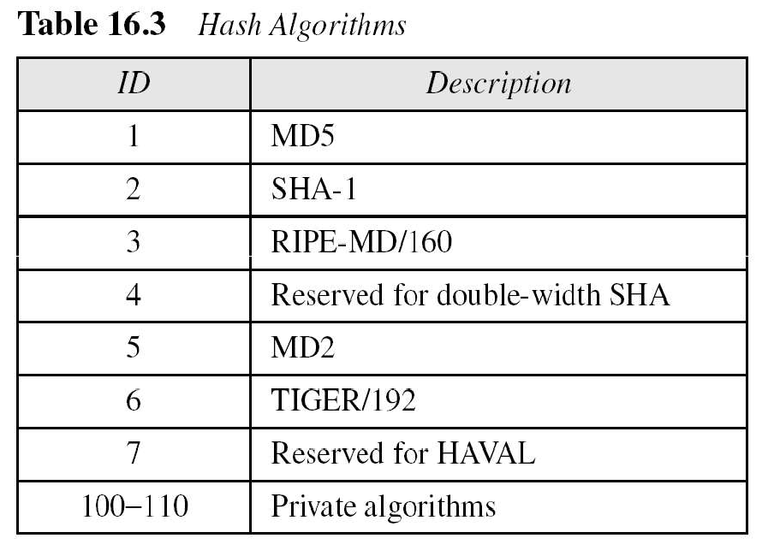
16.2.2 Continued

Slide 17
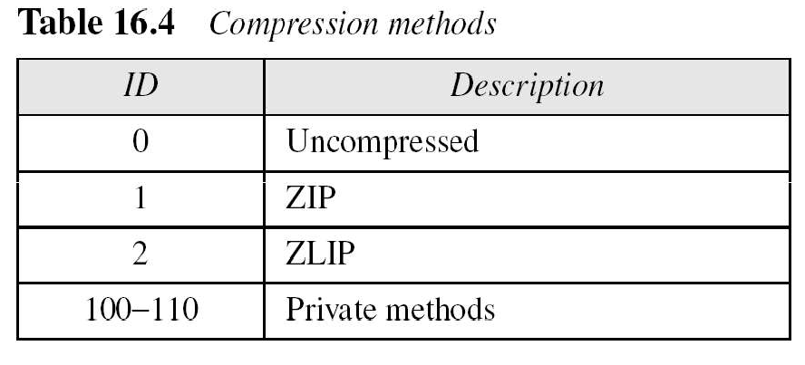
16.2.2 Continued

Slide 18
Another security service designed for electronic mail is Secure/Multipurpose Internet Mail Extension (S/MIME). The protocol is an enhancement of the Multipurpose Internet Mail Extension (MIME) protocol.
16-3 S/MIME
Topics discussed in this section:
MIME
S/MIME
Applications of S/MIME

Slide 19
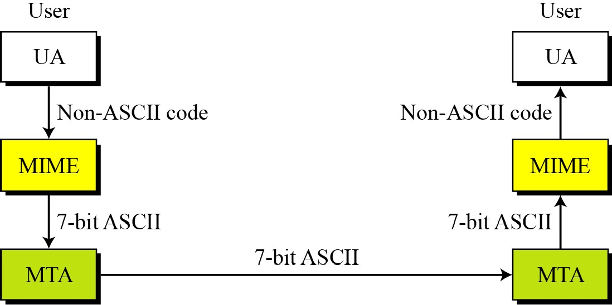
Figure 16.23 MIME
16.3.1 Continued

Slide 20
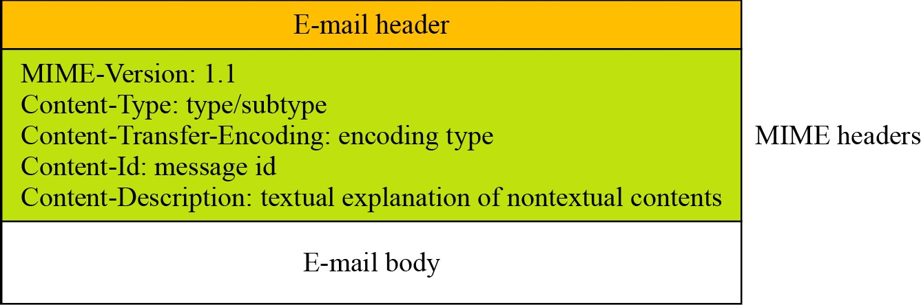
Figure 16.24 Teledesic
16.3.1 Continued

Slide 21
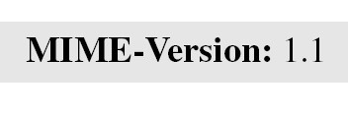
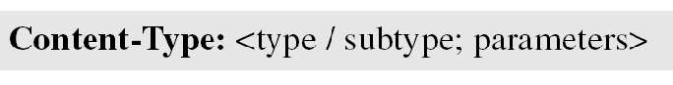
MIME-Version
This header defines the version of MIME used. The current version is 1.1.
16.3.1 Continued
Content-Type
The content type and the content subtype are separated by a slash. Depending on the subtype, the header may contain other parameters.

Slide 22
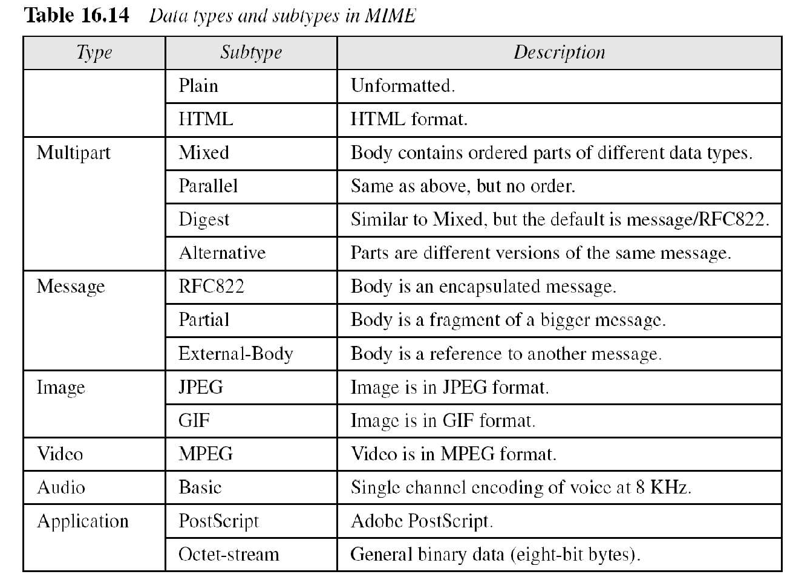
16.3.1 Continued

Slide 23
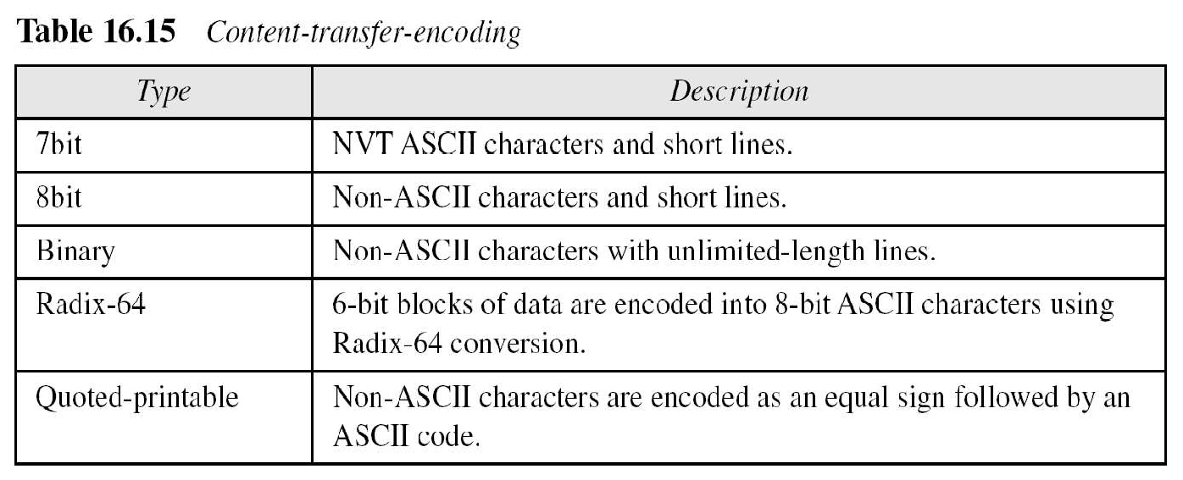
16.3.1 Continued
40

Slide 24
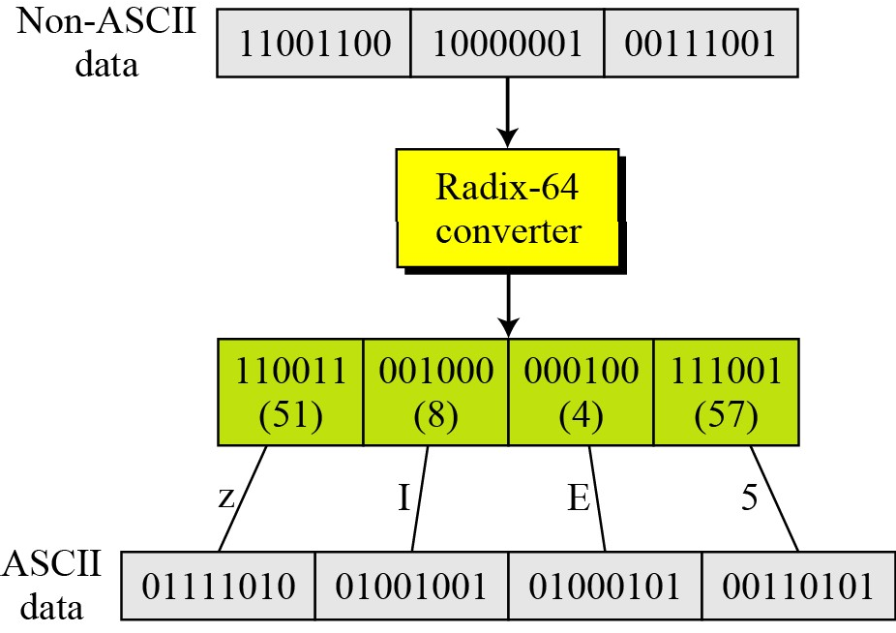
Figure 16.25 Radix-64 conversion
16.3.1 Continued

Slide 25
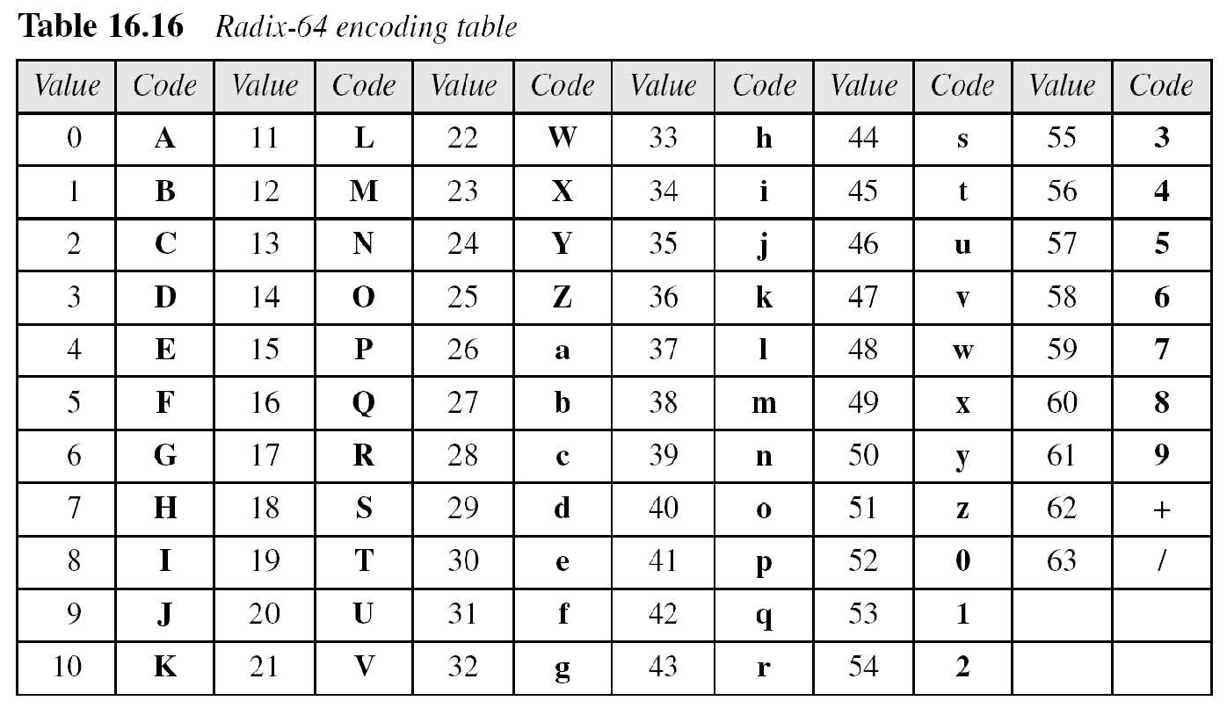
16.3.1 Continued

Slide 26
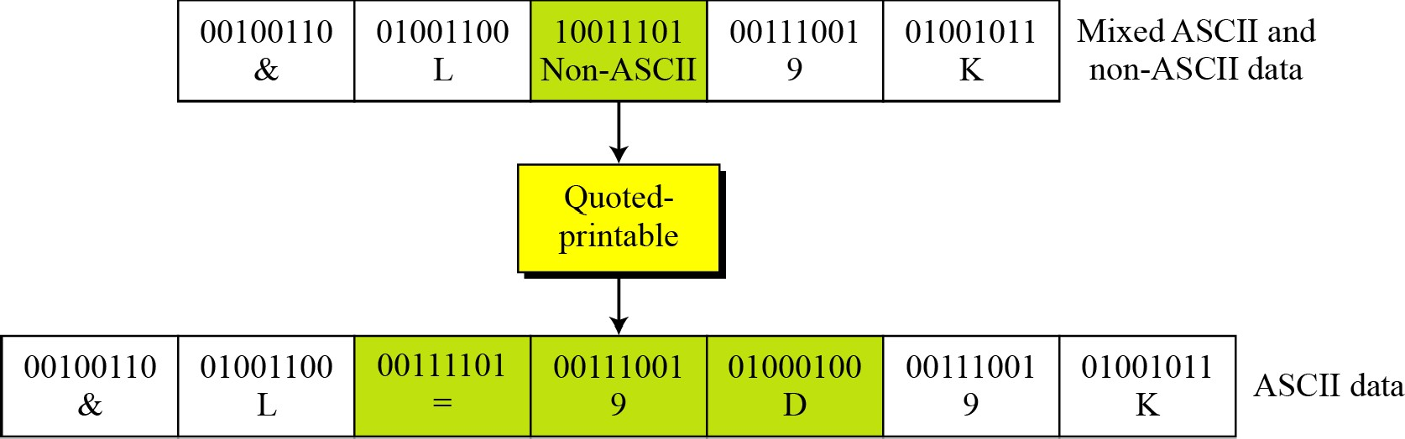
Figure 16.26 Quoted-printable
16.3.1 Continued

Slide 27
S/MIME adds some new content types to include security services to the MIME. All of these new types include the parameter “application/pkcs7-mime,” in which “pkcs” defines “Public Key Cryptography Specification.”
16.3.2 S/MIME
Cryptographic Message Syntax (CMS)
To define how security services, such as confidentiality or integrity, can be added to MIME content types, S/MIME has defined Cryptographic Message Syntax (CMS). The syntax in each case defines the exact encoding scheme for each content type.

Slide 28
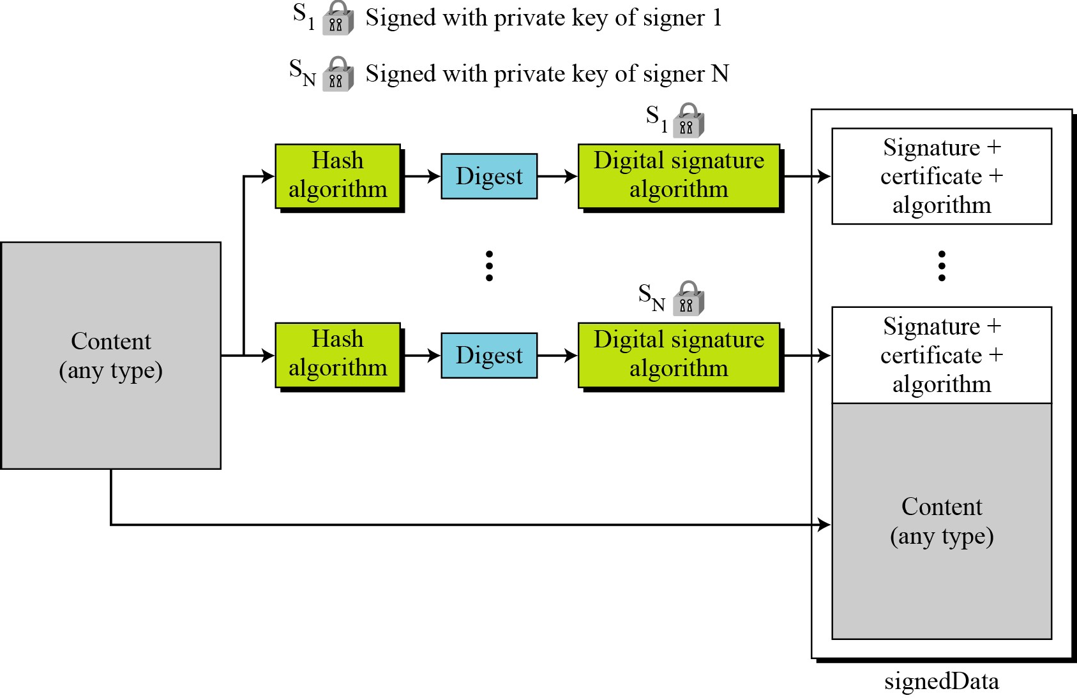
Figure 16.27 Signed-data content type
16.3.2 Continued

Slide 29
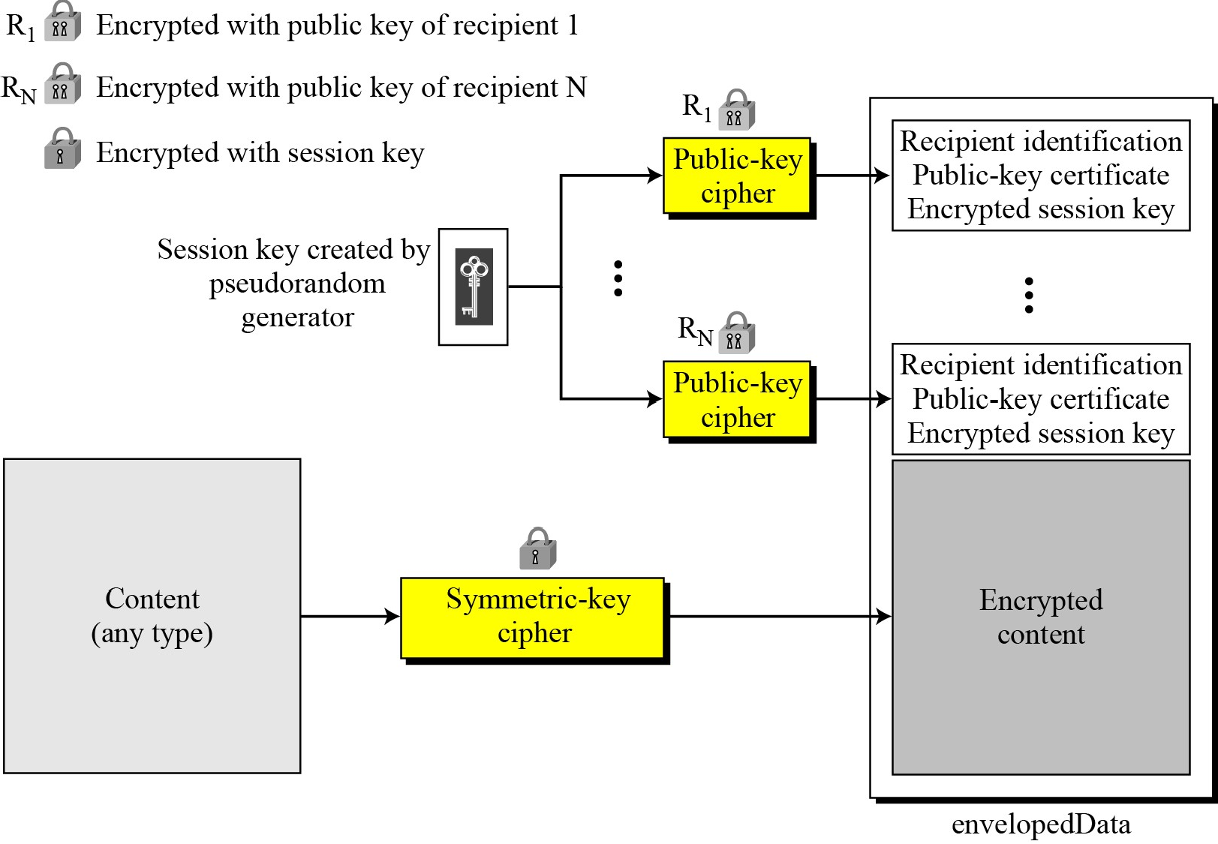
Figure 16.28 Enveloped-data content type
16.3.2 Continued

Slide 30
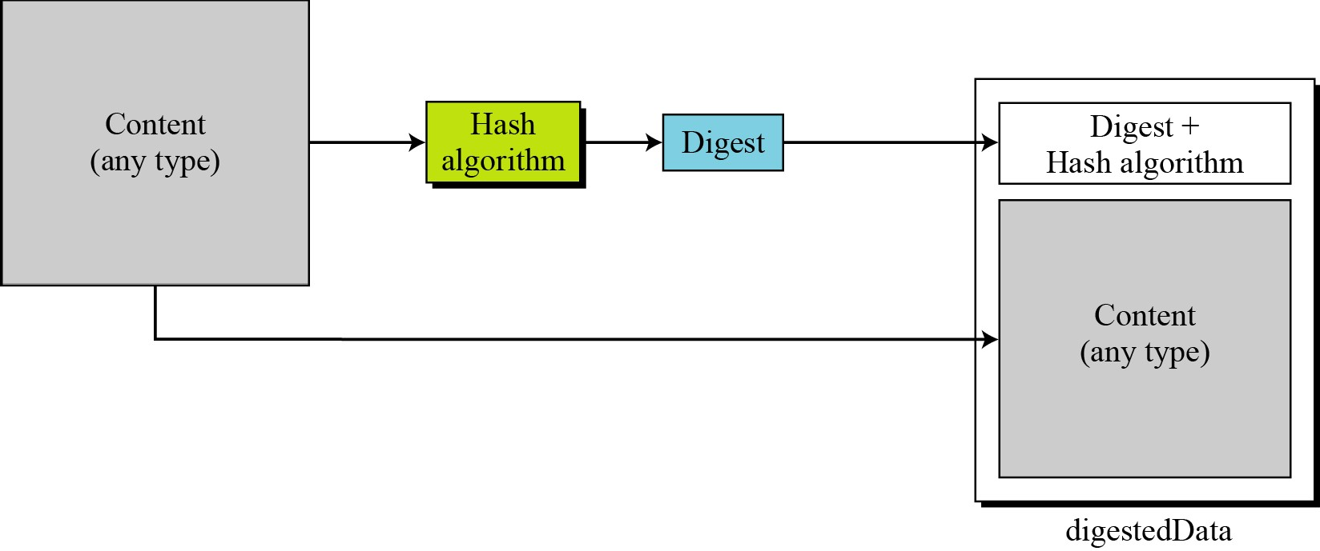
Figure 16.29 Digest-data content type
16.3.2 Continued

Slide 31
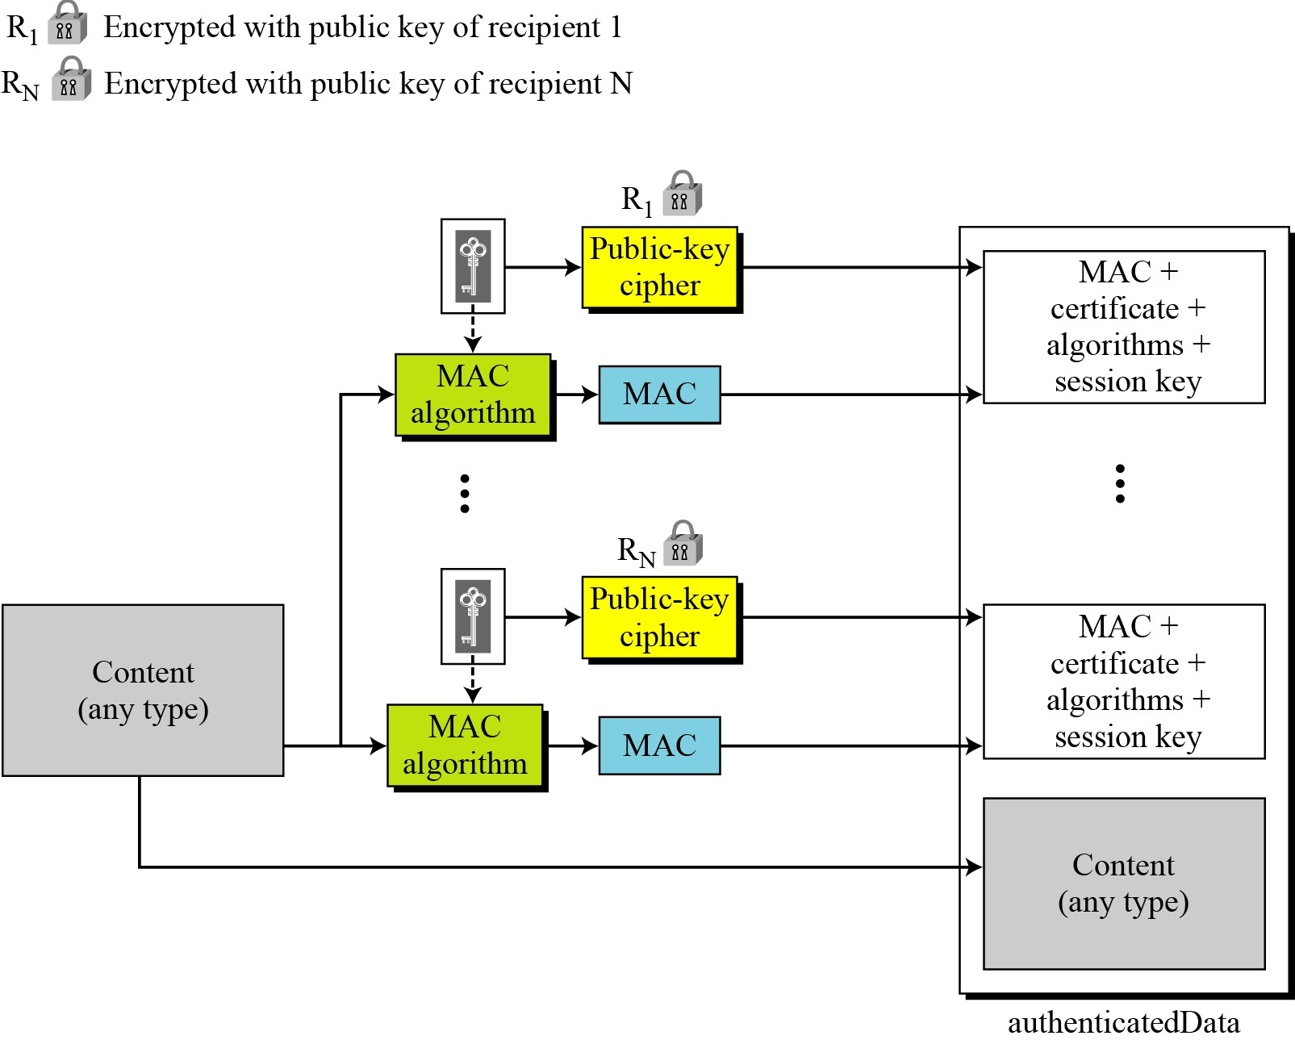
Figure 16.30 Authenticated-data content type
16.3.2 Continued

Slide 32
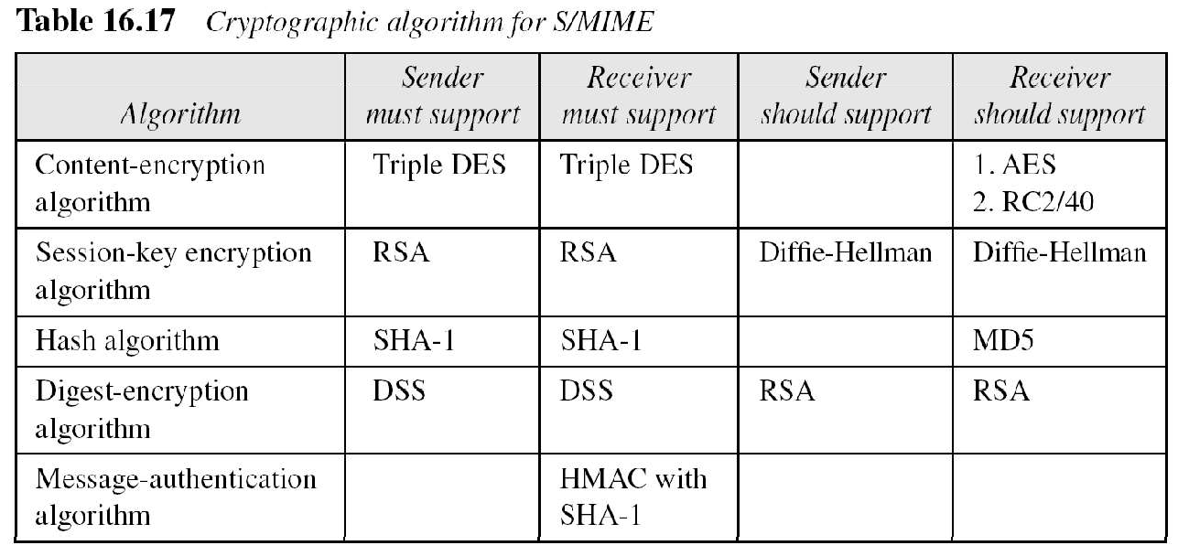
Cryptographic Algorithms
S/MIME defines several cryptographic algorithms. The term “must” means an absolute requirement; the term “should” means recommendation.
16.3.2 Continued

